Slide 1
Over view of TCP/IP

Slide 2
What is the TCP/IP Model?
TCP/IP Model helps you to determine how a specific computer should be connected to the internet and how data should be transmitted between them.
It helps you to create a virtual network when multiple computer networks are connected together. The purpose of TCP/IP model is to allow communication over large distances.
TCP/IP stands for Transmission Control Protocol/ Internet Protocol.
TCP/IP Stack is specifically designed as a model to offer highly reliable and end-to-end byte stream over an unreliable internetwork.

Slide 3
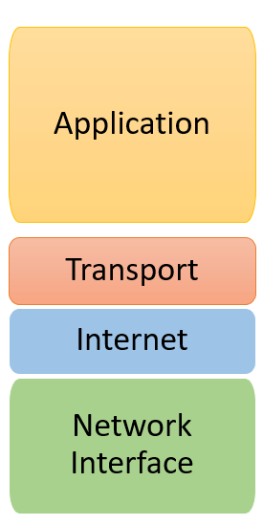
TCP/IP

Slide 4
The functionality of the TCP IP model is divided into four layers, and each includes specific protocols.
TCP/IP is a layered server architecture system in which each layer is defined according to a specific function to perform. All these four TCP IP layers work collaboratively to transmit the data from one layer to another.
Application Layer
Transport Layer
Internet Layer
Network Interface

Slide 5
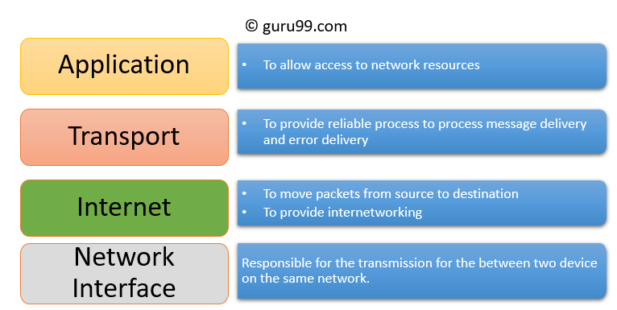

Slide 6
Application Layer
Application layer interacts with an application program, which is the highest level of OSI model. The application layer is the OSI layer, which is closest to the end-user. It means the OSI application layer allows users to interact with other software application.
Application layer interacts with software applications to implement a communicating component. The interpretation of data by the application program is always outside the scope of the OSI model.
Example of the application layer is an application such as file transfer, email, remote login, etc.

Slide 7
The function of the Application Layers are
Application-layer helps you to identify communication partners, determining resource availability, and synchronizing communication.
It allows users to log on to a remote host
This layer provides various e-mail services
This application offers distributed database sources and access for global information about various objects and services.

Slide 8
Transport Layer
Transport layer builds on the network layer in order to provide data transport from a process on a source system machine to a process on a destination system.
It is hosted using single or multiple networks, and also maintains the quality of service functions.
It determines how much data should be sent where and at what rate.
This layer builds on the message which are received from the application layer. It helps ensure that data units are delivered error-free and in sequence.

Slide 9
Transport layer helps you to control the reliability of a link through flow control, error control, and segmentation or de-segmentation.
The transport layer also offers an acknowledgment of the successful data transmission and sends the next data in case no errors occurred. TCP is the best-known example of the transport layer.

Slide 10
Important functions of Transport Layers
It divides the message received from the session layer into segments and numbers them to make a sequence.
Transport layer makes sure that the message is delivered to the correct process on the destination machine.
It also makes sure that the entire message arrives without any error else it should be retransmitted.

Slide 11
Internet Layer
The main work of this layer is to send the packets from any network, and any computer still they reach the destination irrespective of the route they take.
The Internet layer offers the functional and procedural method for transferring variable length data sequences from one node to another with the help of various networks.
Message delivery at the network layer does not give any guaranteed to be reliable network layer protocol.
Layer-management protocols that belong to the network layer are:
Routing protocols
Multicast group management
Network-layer address assignment.

Slide 12
The Network Interface Layer
This layer is also called a network access layer. It helps you to defines details of how data should be sent using the network.
It also includes how bits should optically be signaled by hardware devices which directly interfaces with a network medium, like coaxial, optical, coaxial, fiber, or twisted-pair cables.
This layer defines how the data should be sent physically through the network.
This layer is responsible for the transmission of the data between two devices on the same network.

Slide 13
OSI Model | TCP/IP model
It is developed by ISO (International Standard Organization) | It is developed by ARPANET (Advanced Research Project Agency Network).
OSI model provides a clear distinction between interfaces, services, and protocols. | TCP/IP doesn’t have any clear distinguishing points between services, interfaces, and protocols.
OSI refers to Open Systems Interconnection. | TCP refers to Transmission Control Protocol.
OSI model, the transport layer is only connection-oriented. | A layer of the TCP/IP model is both connection-oriented and connectionless.
OSI layers have seven layers. | TCP/IP has four layers.

